Slide 1
Switching Execution Context

Slide 2
Operators provided by Reactive for Context Switching
publishOn
susbcribeOn
runOn

Slide 3
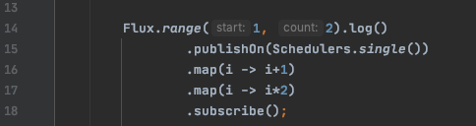
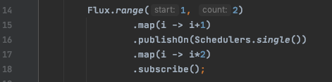
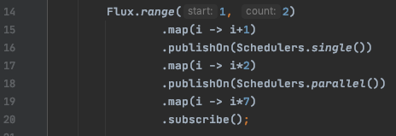
publishOn operator
Where you place the publishOn in the chain matters.
onSubscribe, onNext executed on Main method.
What ever downstream operations that are below the publishOn will be executed on Single Thread.

Slide 4
susbcribeOn operator

